Slide 1
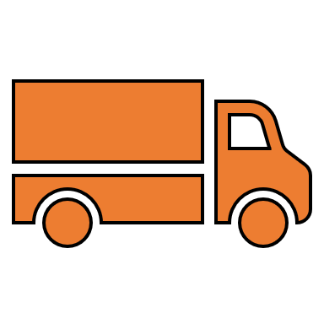
1
Driver Reports Defects
2
3
Defects received to DVIR Module
GEOTAB DVIR Integration
Individual Reviews and decides next steps
4
Work Orders Created in RTA Software or report is closed
6
5
Results communicated back to GEOTAB via integration
Technicians complete workorder in RTA Software
Helping Fleets Succeed For More Than 40 Years

